Slide 1
What Makes a Healthy Soil?

Slide 2
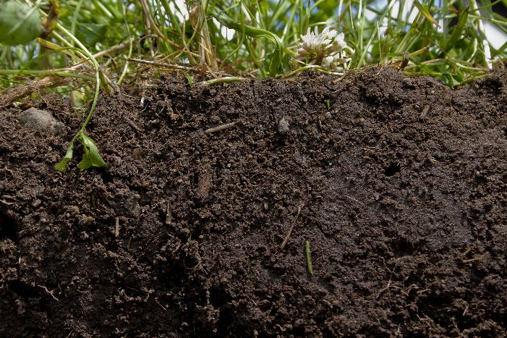
Components of a healthy soil
The Level of Soil Organic Matter Is Maintained
Functionality maintained (substrate, role in soil structure, ground cover)
Net carbon sequestration
Soil organic matter level matching land use and soil texture

Slide 3
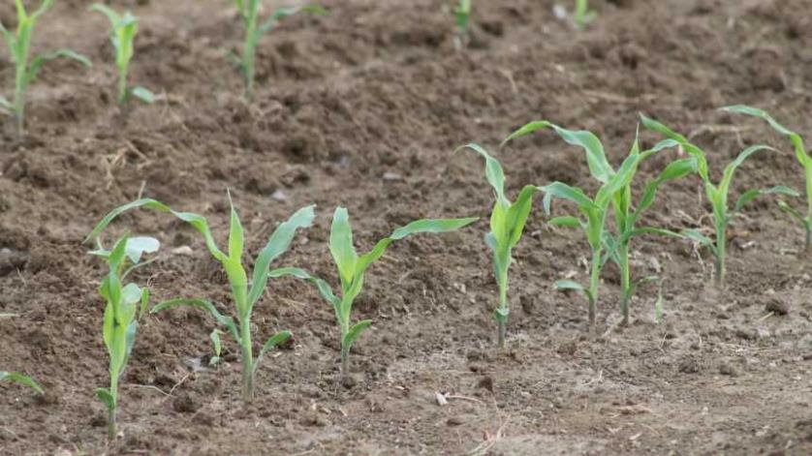
Components of a healthy soil
Soil Fertility Is Optimized
Nutrient additions at least match removals and losses
Fertility is adequate for land use
Nutrient storage capacity is maintained

Slide 4
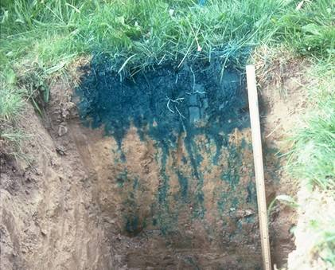
Components of a healthy soil
Optimized Water Entry, Storage and Supply
Water infiltration, permeability and storage maximized to meet land-use needs
Drainage is minimized where there is risk of dryland salinity or acidification
No constraints to water use (supply function)

Slide 5
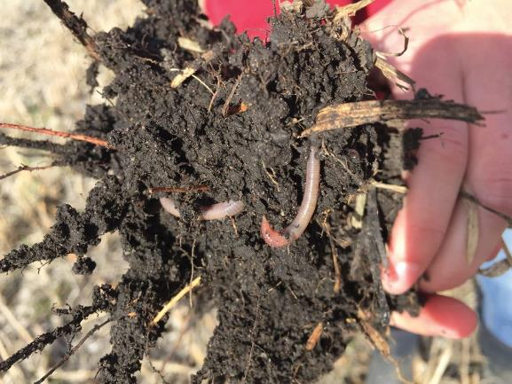
Components of a healthy soil
Enhanced Soil Biological Function
Resilient and diverse biological community (self-regulating)
Biota undertake key functions, such as nutrient recycling
Optimal biological functioning (efficient, beneficial, dynamic)
Absence of disease expression

Slide 6
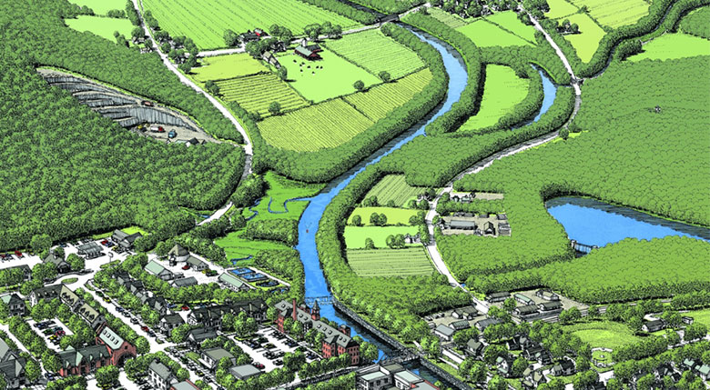
Components of a healthy soil
Supports Productive Land Uses
Supports plant growth/land use requirements
Maintains resource condition and ecosystem services

Slide 7
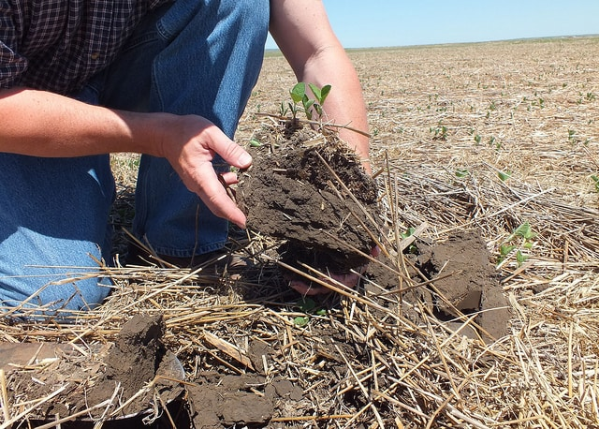
Components of a healthy soil
Enhances Environmental and Community Health and Well-Being
Healthy soils = healthy food = healthy people
Profitable while conserving soil resource and reducing environmental impact
Fit for purpose

Slide 8
Life below ground supports life above ground
Organisms | Number (per 10 ft²)
Bacteria and Archaea | 100 trillion – 1 quadrillion
Actinobacteria | 1 – 10 trillion
Fungi | 1 – 10 million per 3 ft.
Algae | 1 – 10 billion
Protists | 10 million – 100 billion
Nematodes | 100,000 – 10 million
Mites | 100 – 1 million
Collembola | 100 – 1 million
Earthworms | 10 – 100
Other fauna | 100 – 10,000
Sources: Weil & Brady, The Nature and Properties of Soil, 15 e; Lindo, Kozlowski & Robinson (eds). Know Soil Know Life; Orgiazzi, Bardgett, Barrios et al. 2016. Global Soil Biodiversity Atlas

